Slide 1

Housing price prediction
By Nimit shah

Slide 2
Table of contents
Introduction
Analytical Problem Framing
Data Analysis
Assumptions
Machine Learning Models
Results and Conclusion
Limitations and Scope for Future Work

Slide 3
Introduction
Houses are one of the necessary need of each and every person around the globe and therefore housing and real estate market is one of the markets which is one of the major contributors in the world’s economy. It is a very large market and there are various companies working in the domain.
A US-based housing company named Surprise Housing has decided to enter the Australian market. The company uses data analytics to purchase houses at a price below their actual values and flip them at a higher price. For the same purpose, the company has collected a data set from the sale of houses in Australia.
The company is looking at prospective properties to buy houses to enter the market. You are required to build a model using Machine Learning in order to predict the actual value of the prospective properties and decide whether to invest in them or not. For this company wants to know:
Which variables are important to predict the price of variable?
How do these variables describe the price of the house?

Slide 4
Analytical problem framing
In this Machine Learning project, I will be predicting the sale price of the houses in Australian region using the provided dataset
The Surprise Housing company expects us to predict the sale price of the house along with the important variables which helps in prediction of the same
Further, we will also learn on how these variables describe the sale price of the house
The provided dataset consists of 1460 rows and 81 features (including train and test dataset)

Slide 5
Data analysis
Before we can proceed with data analysis part, there are missing data in some of the variables which needs to be handled
the variables like LotFrontage, Alley, MasVnrType, MasVnrArea, BsmtQual, BsmtCond, BsmtExposure, BsmtFinType1, BsmtFinType2, FireplaceQu, GarageType, GarageYrBlt, GarageFinish, GarageQual, GarageCond, PoolQC, Fence and MiscFeature have missing data.

Slide 6
Firstly, I’m removing the variables that contains ‘missing data’ more than 80%.
We can clearly see that for the variables 'Alley', 'MiscFeature' and 'PoolQC', there are more than 80% data is missing, hence removing the same. Further I’m also removing ‘Id’ because it is unique for each row and will not help in the Prediction of sale price.
Further, I’m imputing all the other variables containing null values using KNN Imputer and fillna method
Using the above technique, I have successfully handled the null values in the dataset.

Slide 7
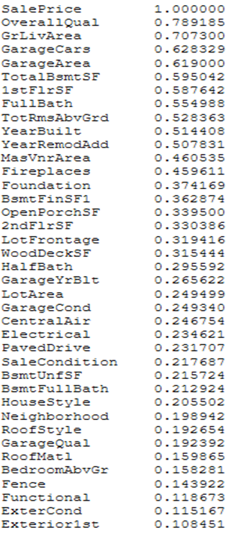
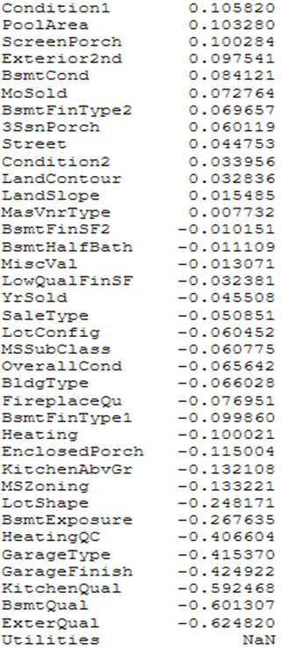
Checking for correlation of independent variable with the target

Slide 8
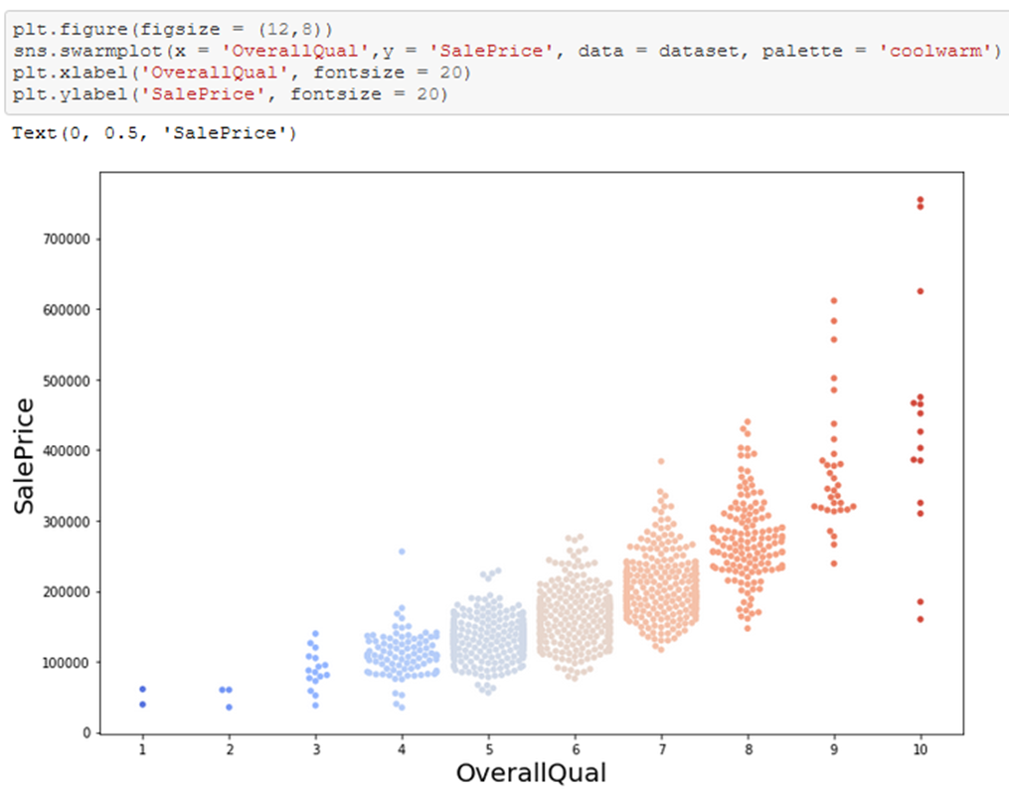
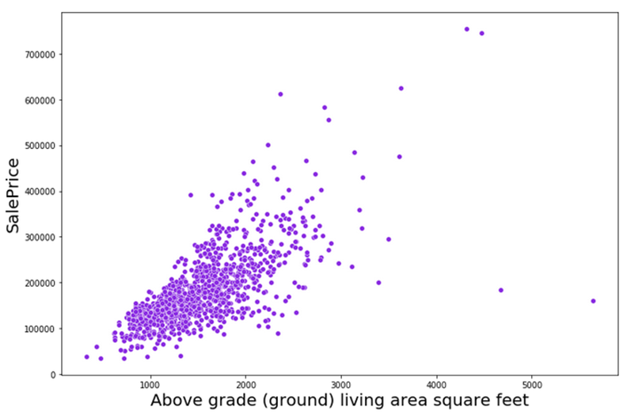
Now I’m visualizing the correlation between independent variables with the dependent variable having correlation coefficient greater than 0.3
Overall Quality and Sale Price GrLivArea and SalePrice
higher the overall quality of the house, higher the sale price and they and directly proportional to each other. Further, the larger the space of living area, the higher the price of the property.

Slide 9
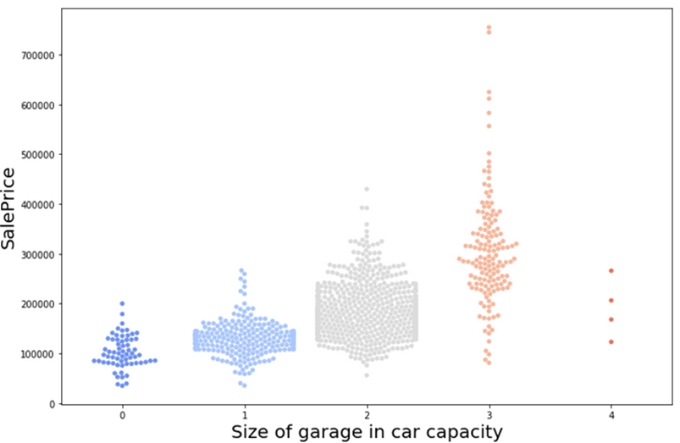
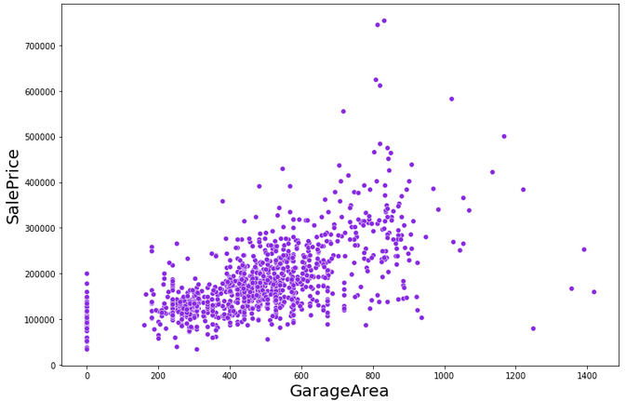
GarageCars and SalePrice GarageArea and SalePrice
Bigger the garage size in car parking capacity, higher the price of the property and There is an average positive relationship with Garage Area and Sale Price, the Sale price of a property increases with the increase in garage area

Slide 10
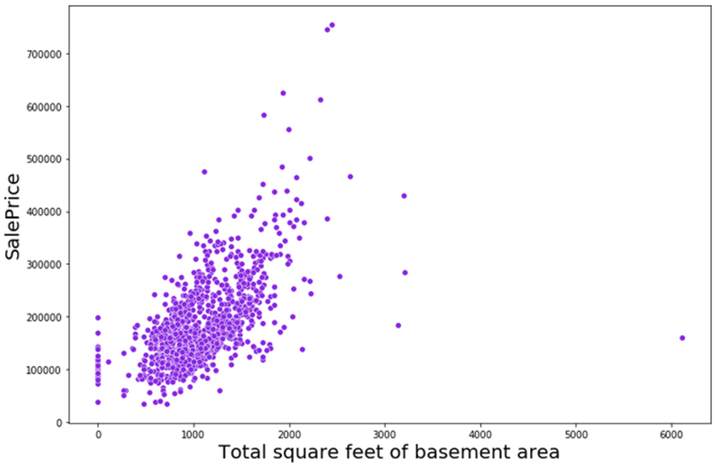
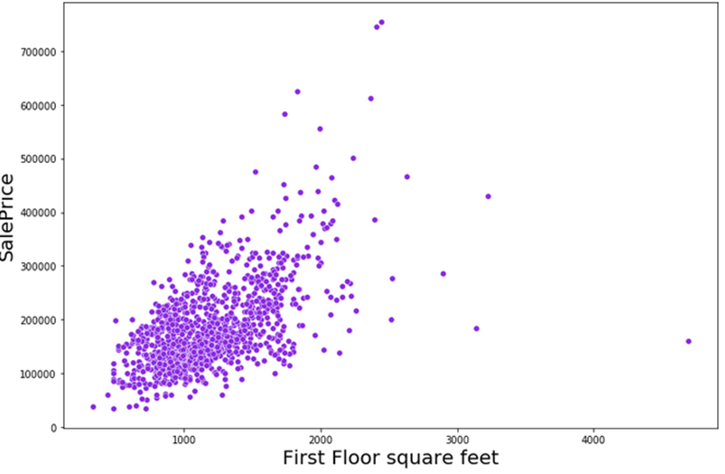
TotalBsmtSF and SalePrice 1stFlrSF and SalePrice
There is an average positive relationship with Basement Area and Sale Price, the Sale price of a property increases with the bigger basement area and The square feet of the first floor is positively correlated with the sale price. I can say that the bigger the first floor the higher the sale price

Slide 11
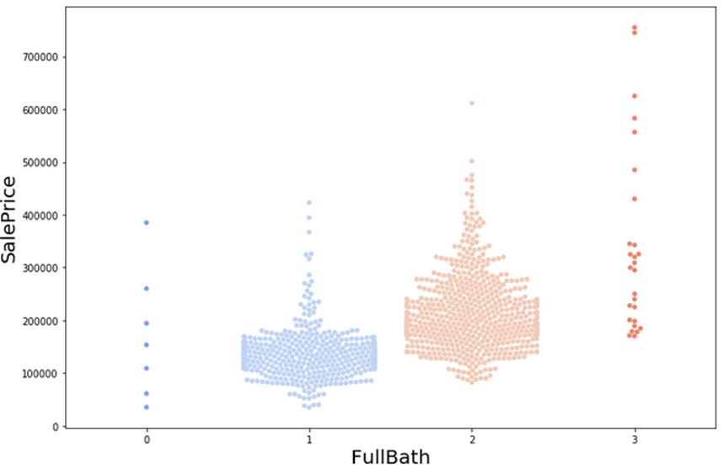
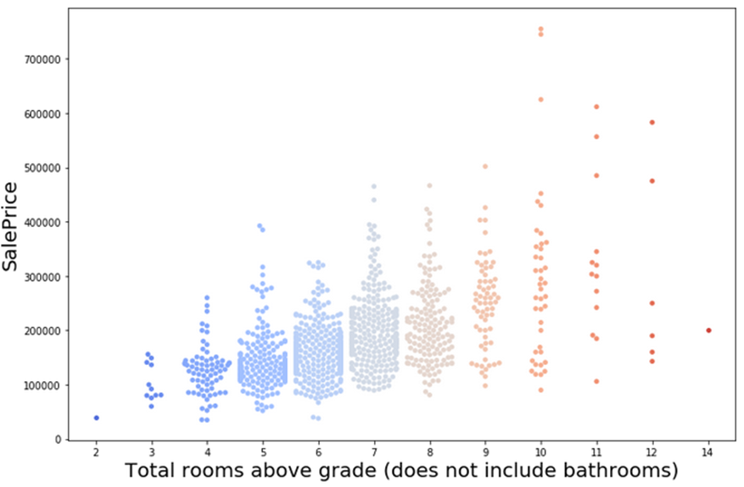
FullBath and Saleprice TotRmsAbvGrd and SalePrice
The properties with more number of full size bathrooms have higher sale price and more number of high grade rooms in a house, higher its price. We can view the same from the above plots

Slide 12
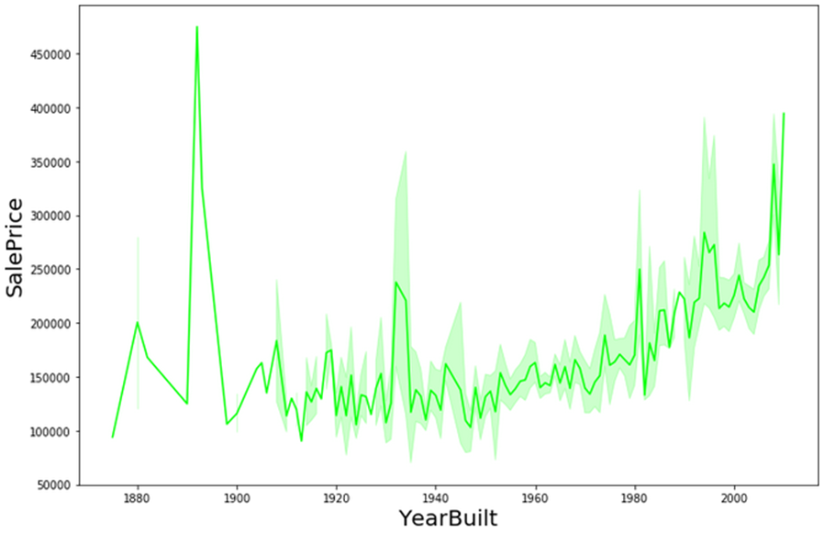
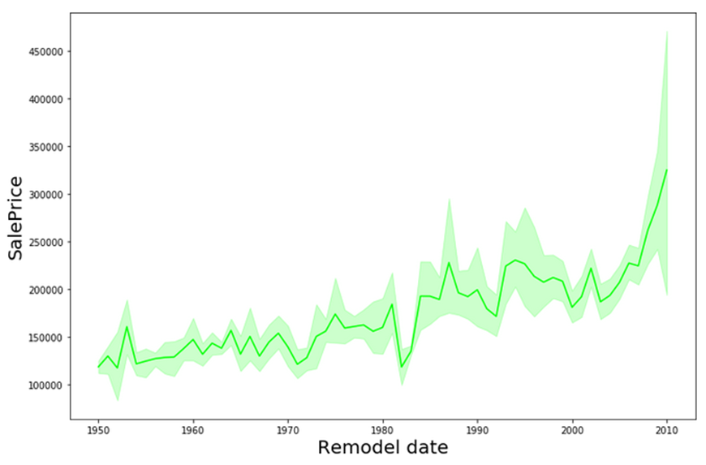
YearBuilt and SalePrice YearRemodAdd and SalePrice
From the overall analysis, newer the house, the higher its value. Further, we can see that houses built just before 1900s were sold for unusually higher price. Most of the houses weren’t remodeled, however we are looking at the sale prices of the remodeled houses. The Sale price was higher for houses when the remodeling was done recently

Slide 13
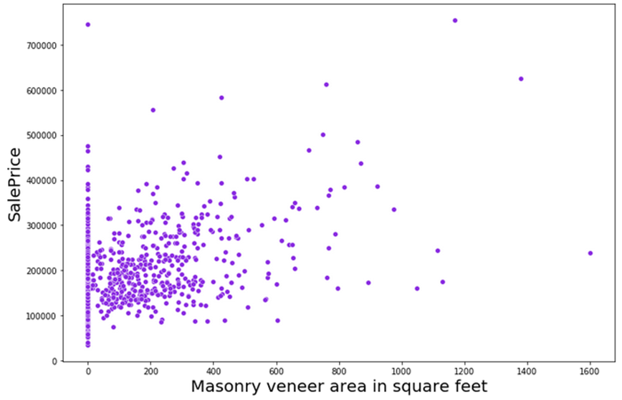
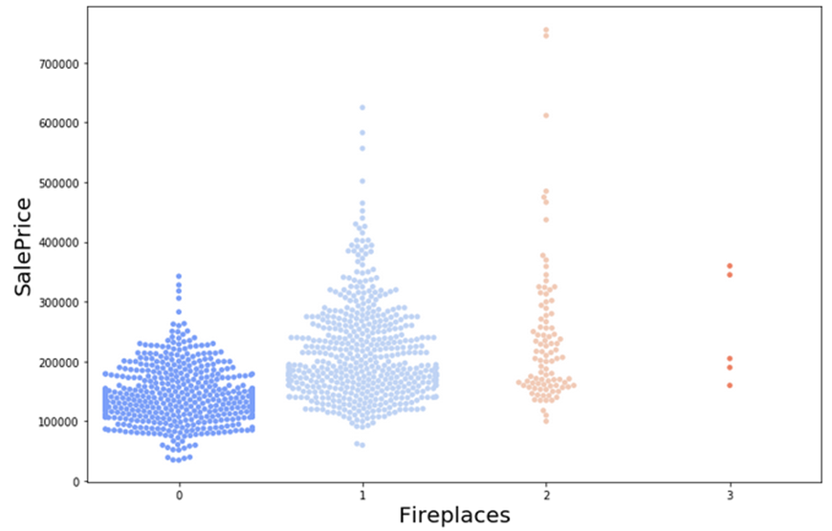
MasVnrArea and SalePrice Fireplaces and SalePrice
Bigger the Masonry veener area, higher were the prices of the houses. We can’t be sure of the relationship because the correlation is below average. Presence of fireplace was preferred by the buyers and they paid a little higher price for the properties containing a fireplace.

Slide 14
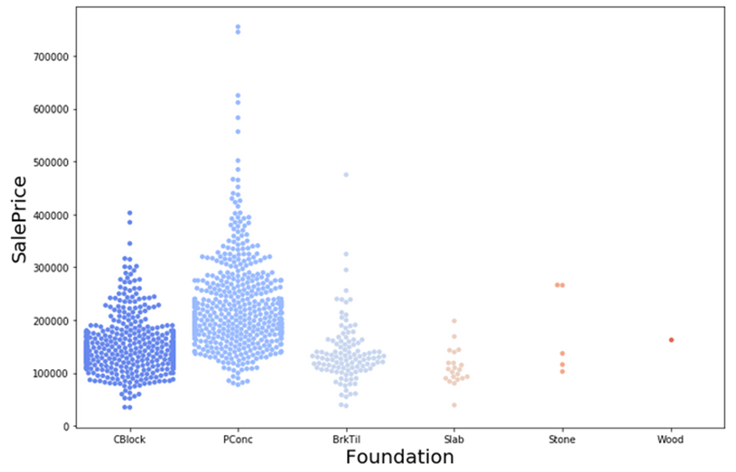
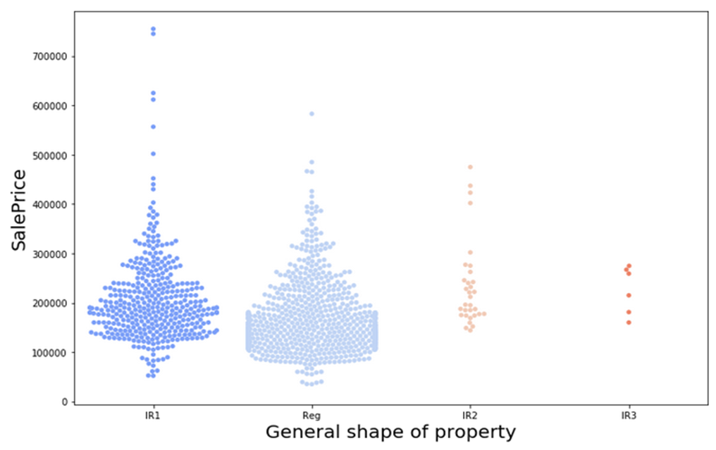
Foundation and SalePrice LotShape and Sale Price
Type of foundation for a house also decided the property (house) price. I can say that the houses built with poured concrete foundation were of higher value and the sale price was higher for the same. The houses with slightly irregular shape were sold for higher prices when compared to regular shaped houses

Slide 15
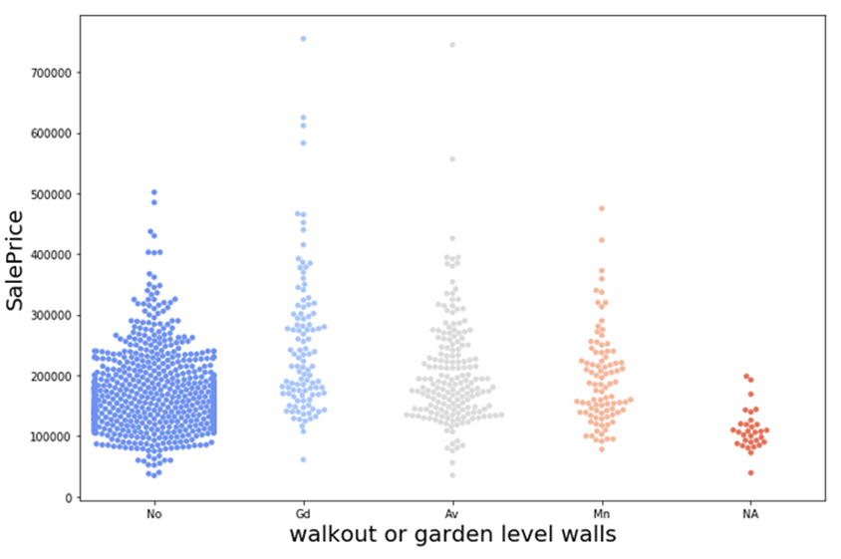
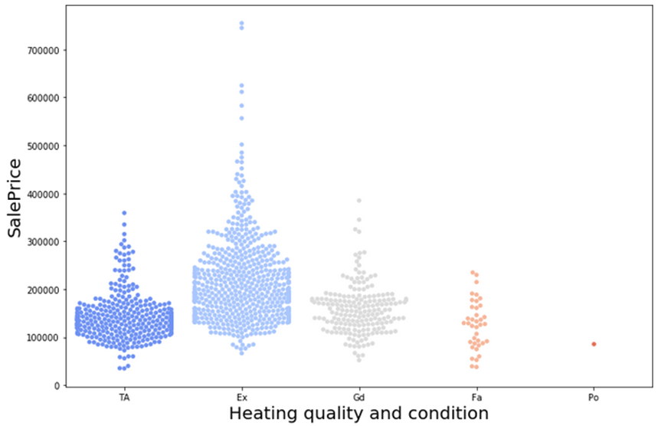
BsmtExposure and SalePrice HeatingQC and Saleprice
The houses with Good walkout walls were sold with slightly higher prices when compared to others and Houses with excellent heating quality were sold at higher prices.

Slide 16
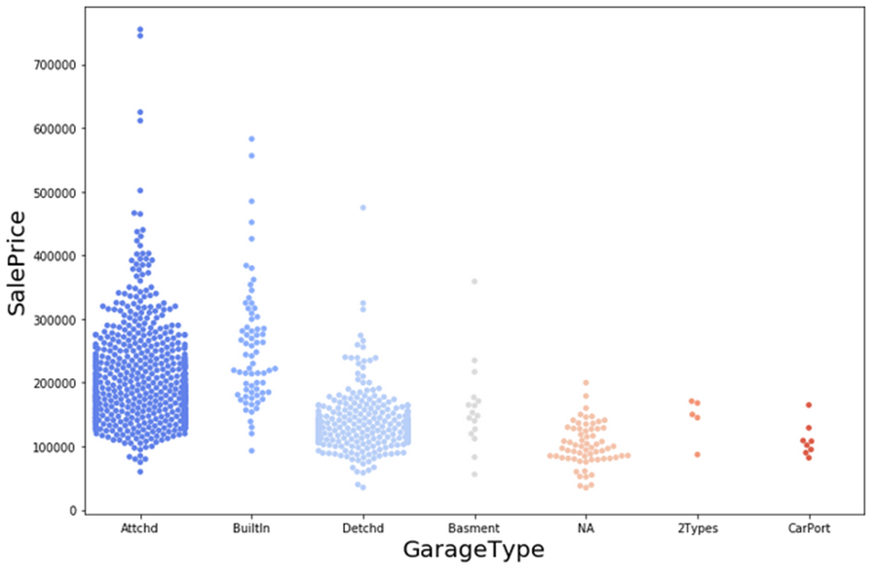
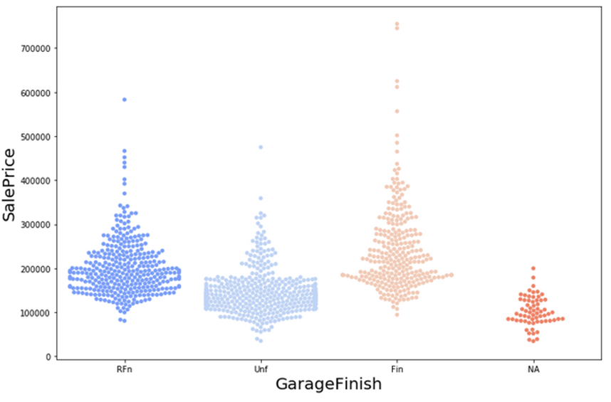
GarageType and SalePrice GarageFinish and SalePrice
Houses with attached and the built-in garages were sold at higher prices and Houses with finished and roughly finished garages were sold at higher prices when compared to others

Slide 17
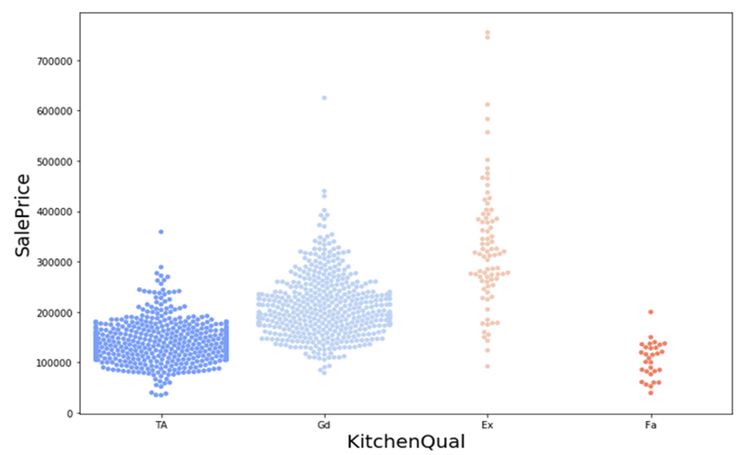
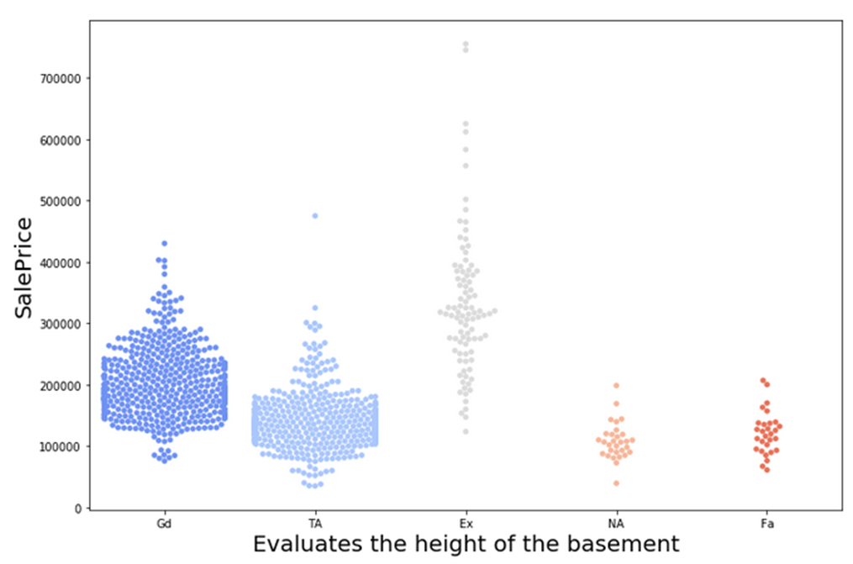
KitchenQual and SalePrice BsmtQual and SalePrice
Higher the quality of kitchen, higher the price of the house and Houses with the higher basement quality were sold at higher prices

Slide 18
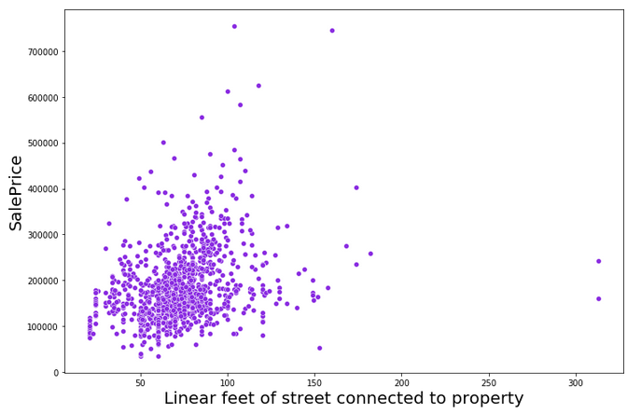
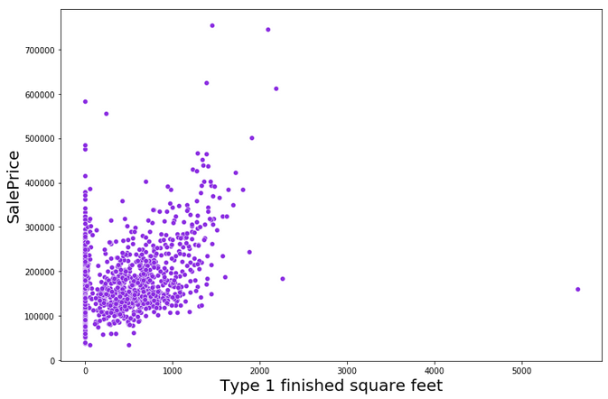
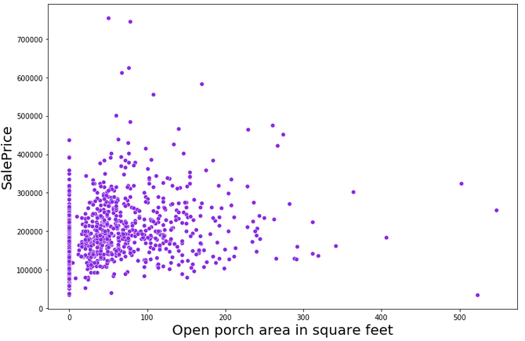
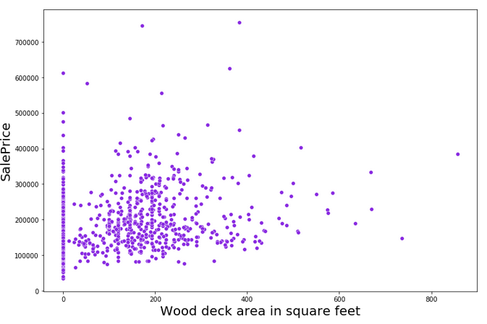
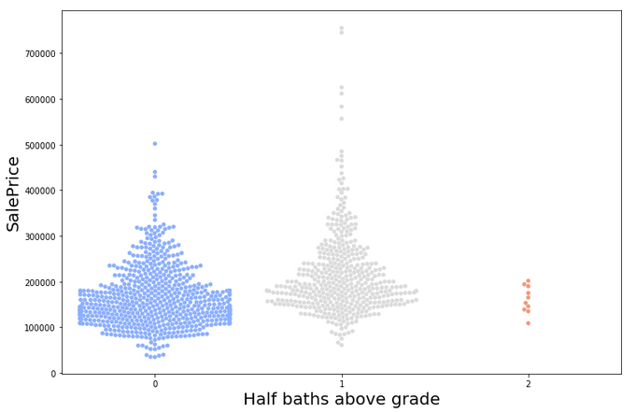
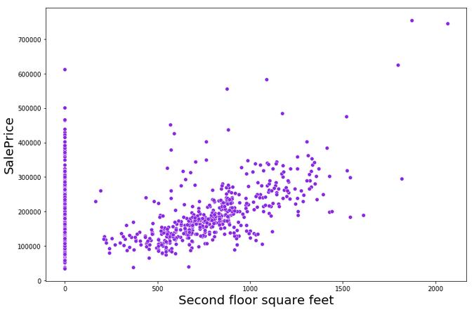
Below are the few positively correlated variable with the target variable

Slide 19
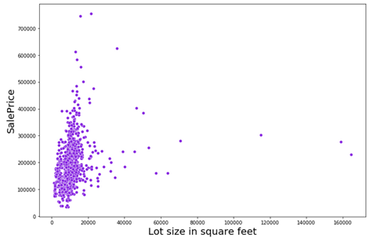
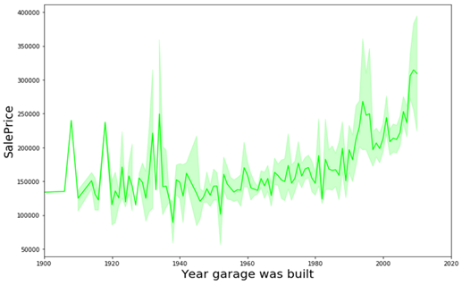
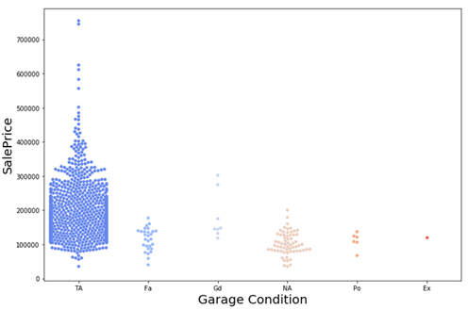
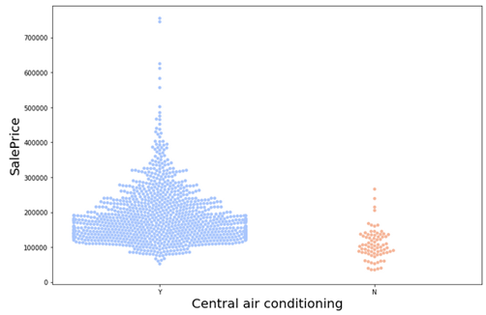
Continued …

Slide 20
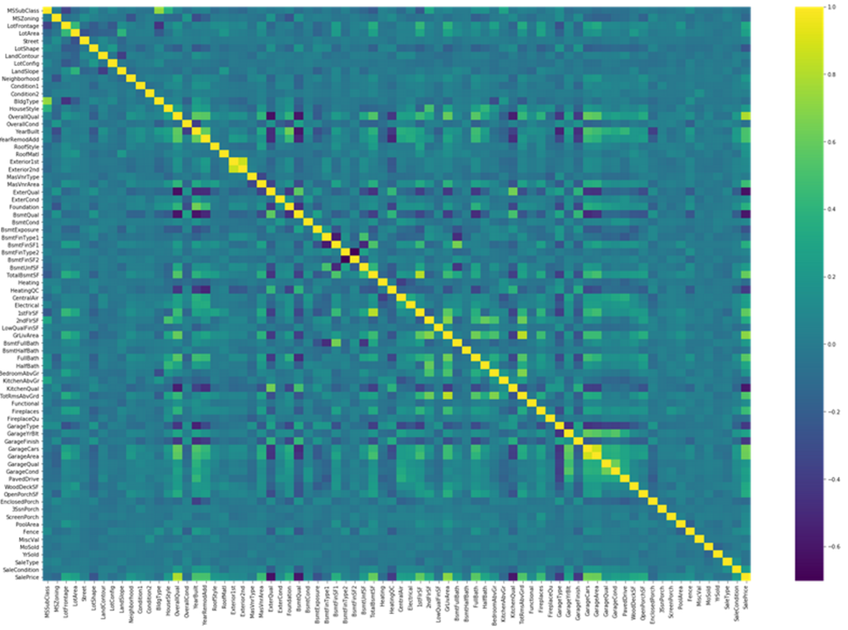
Now that we have visualized the variables that are correlated, we are encoding the categorical variables using ordinal encoder to proceed with further analysis
To determine the multi-collinearity, I’m using heat map from seaborn library to visualize the same

Slide 21
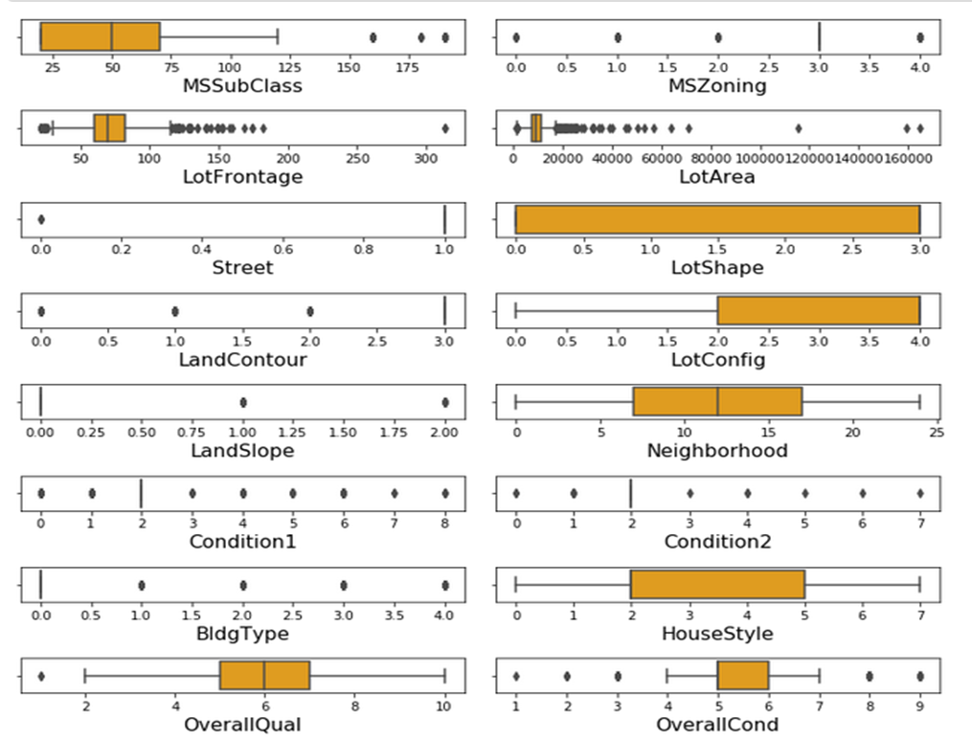
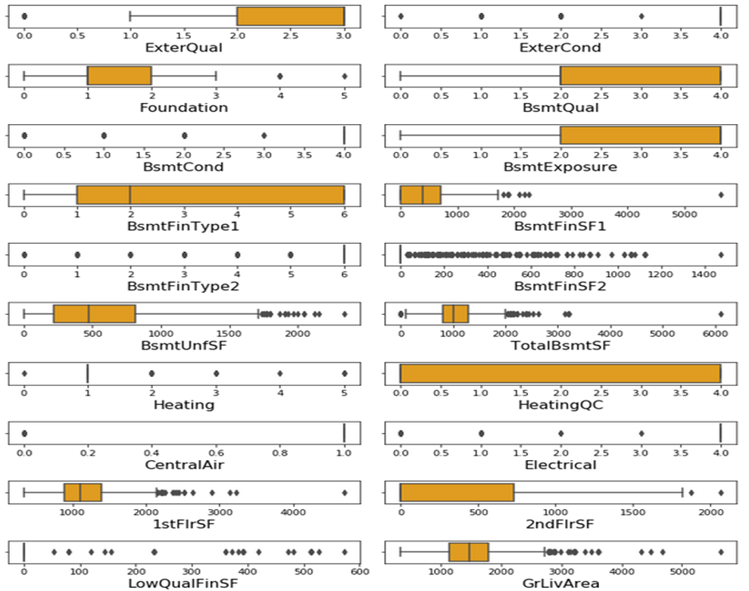
Checking for outliers in the dataset using the boxplot method

Slide 22
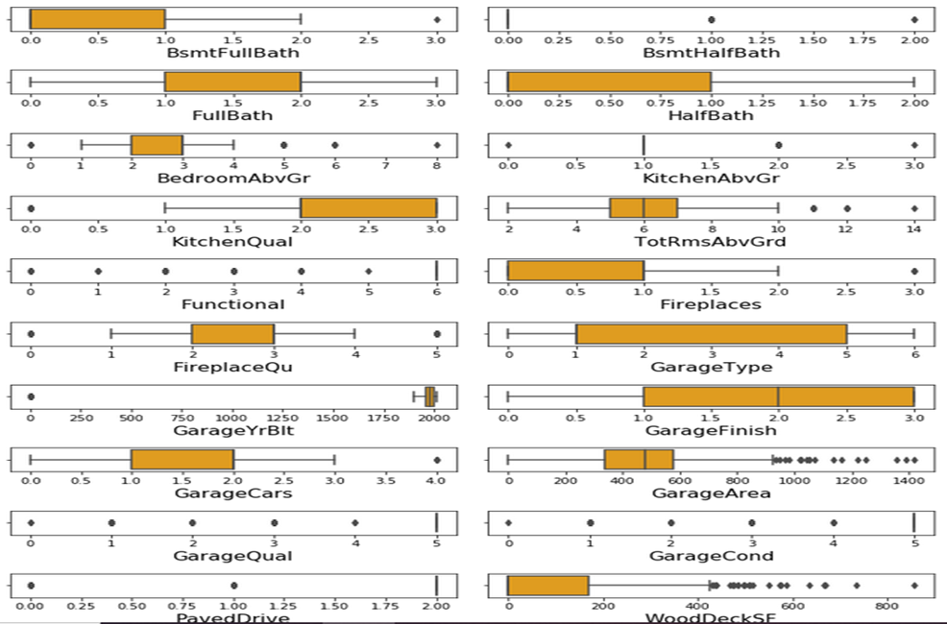
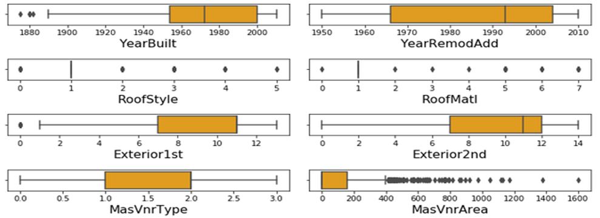
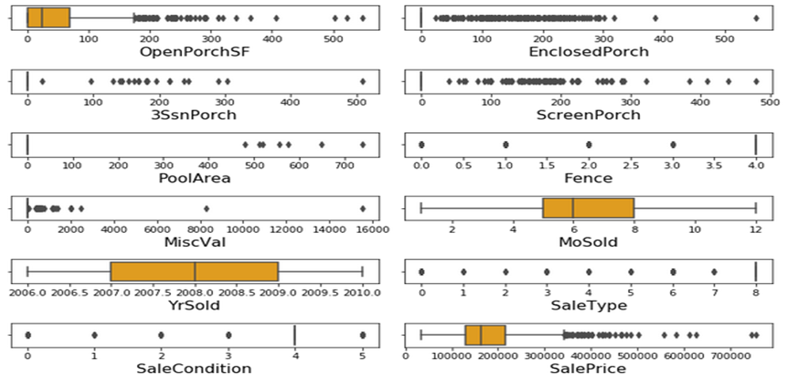
Continued…

Slide 23
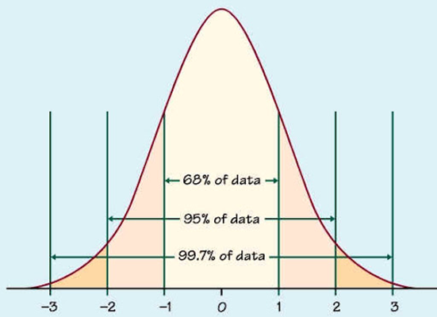
The previous slide clearly implies that lot of variables has outliers in the data and we can remove them using the statistics.
First we find the p-value of each and every data point and we take only data with less than 3 p-value.
It is assumed that close to 99.7% data lies between -3 to +3 standard deviation. We can consider the remaining data (0.03) to be outlier.
Therefore using the z-score method, I’m taking the data within the range of -3 to +3 standard deviation to control the outlier.

Slide 24
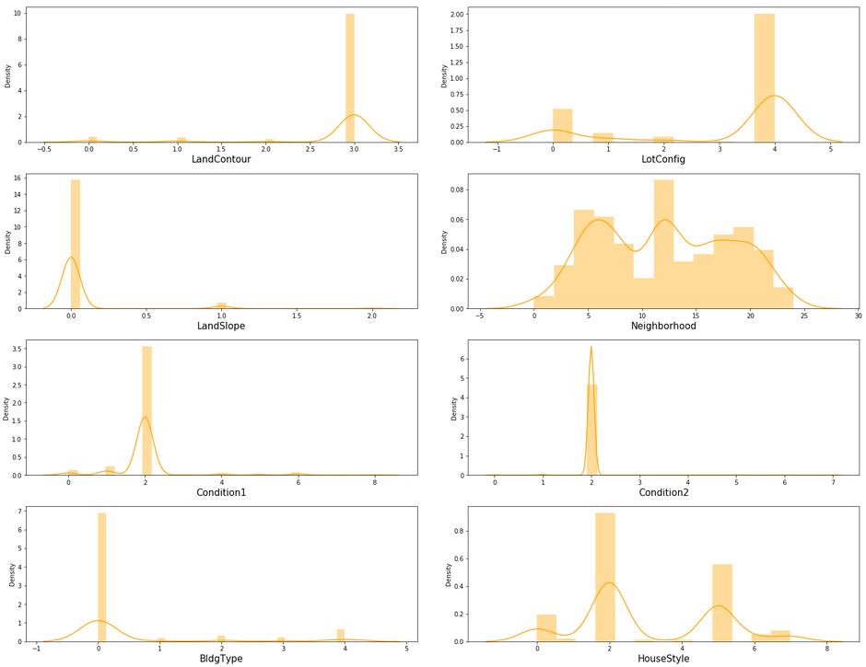
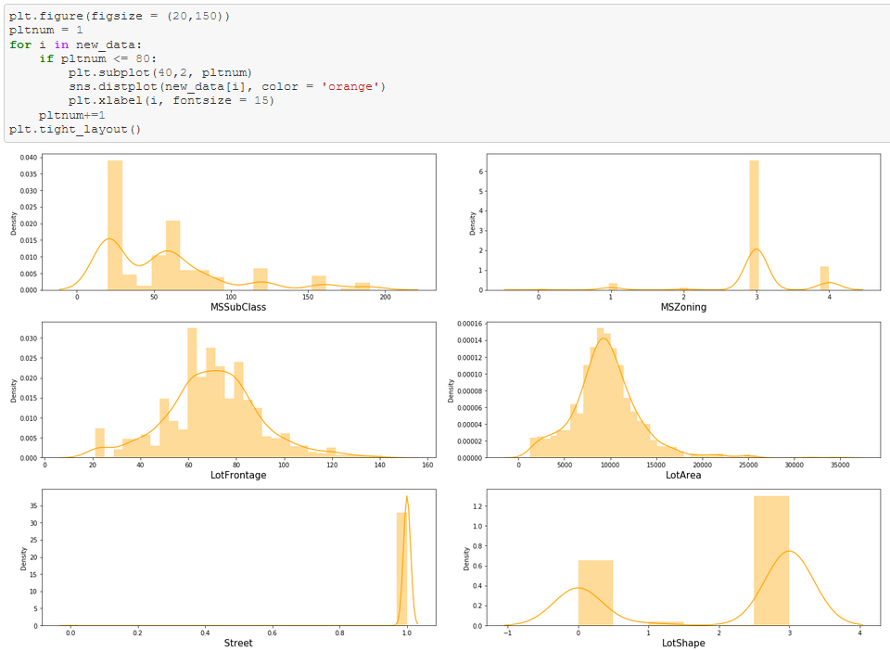
Checking for the data distribution using distribution plot from Seaborn library to check and control skewness
Checking for skewness in the dataset using the distribution plot from a seaborn library

Slide 25
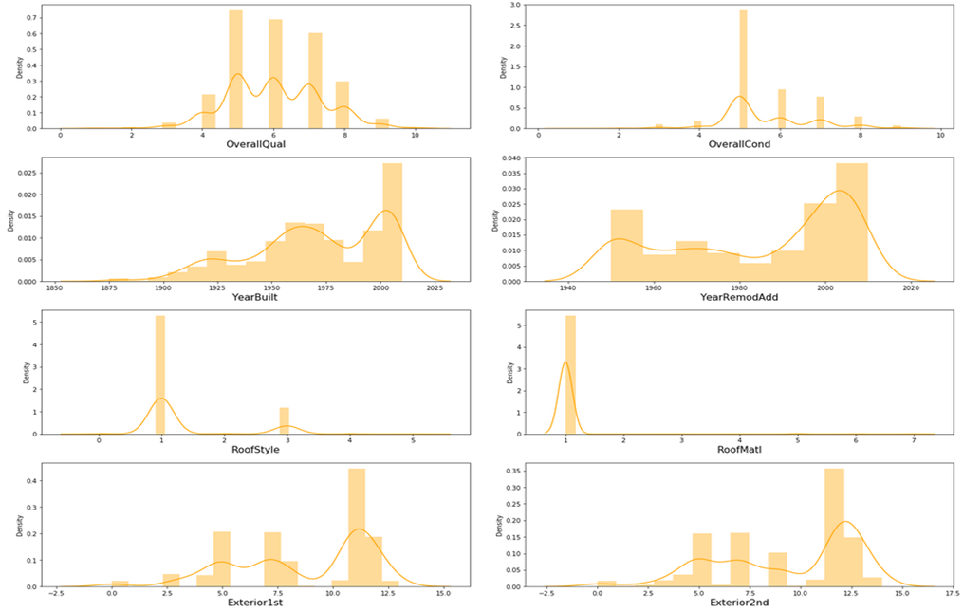
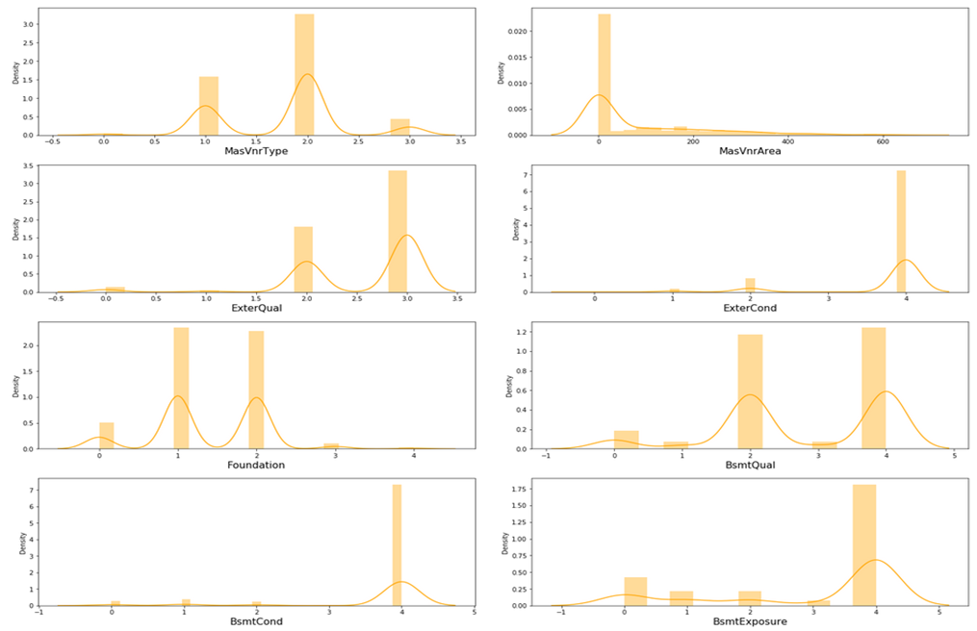
Continued…

Slide 26
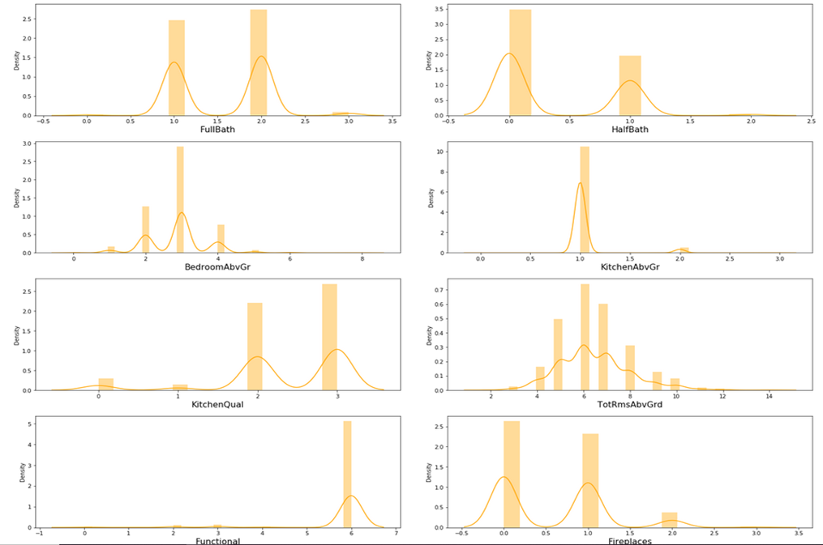
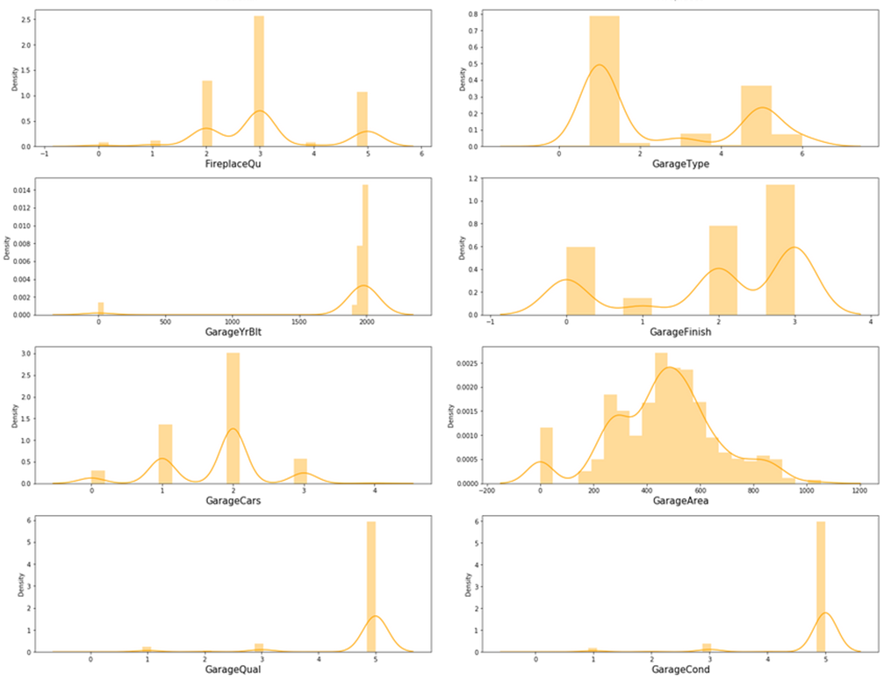
Continued…

Slide 27
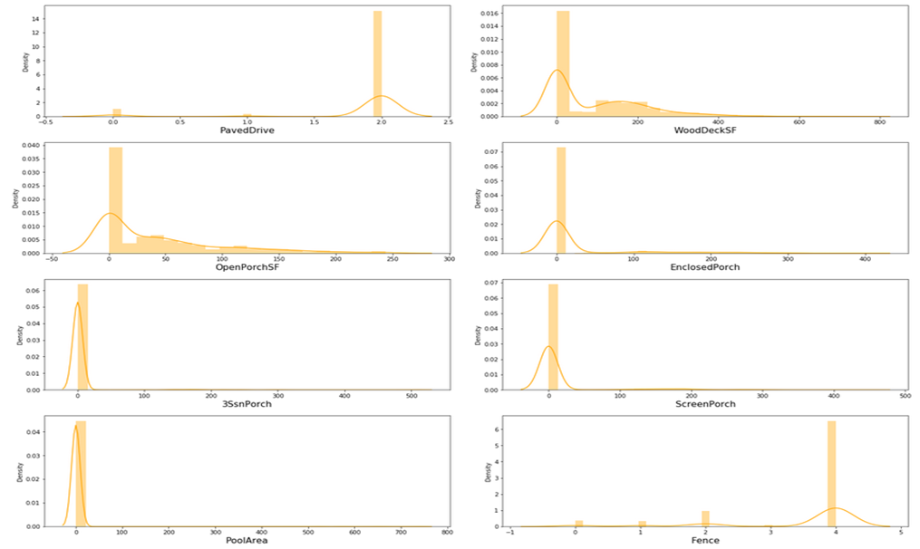
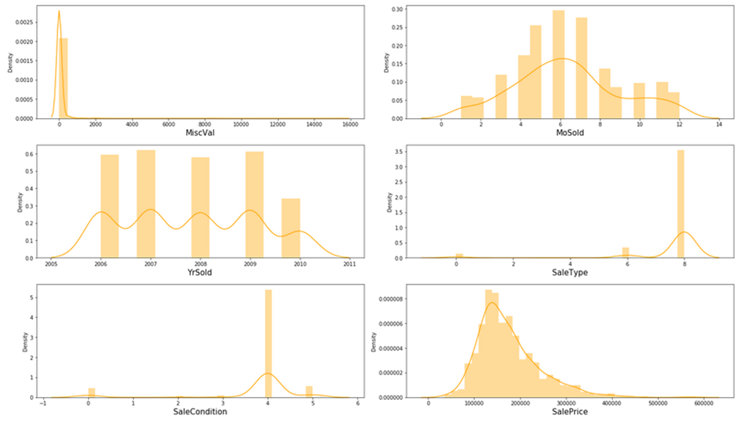
Continued…

Slide 28
From the previous slides, we can clearly see that there are few ordinal variables, few continuous variables and most part with categorical variables.
In order to be a good dataset, we assume that all the continuous variables follow normal distribution. However I can see that the continuous columns are skewed and we will have to control skewness to make data follow normal distribution.
It is considered that the skewness co-efficient within the range of -0.5 to +0.5 is acceptable. Proceeding with the same assumption to get the skewness under control.
In order to perform the same we are using power transformation using ‘yeo-johnson’ method on the entire dataset excluding the target variable

Slide 29
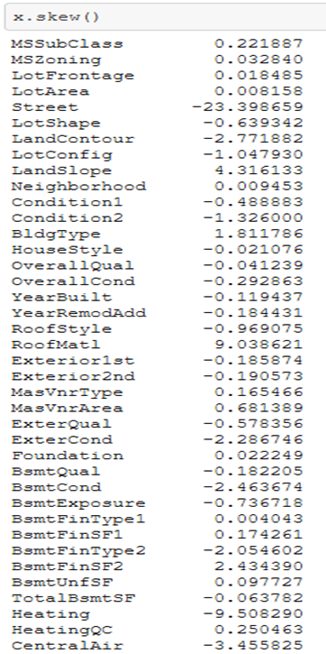
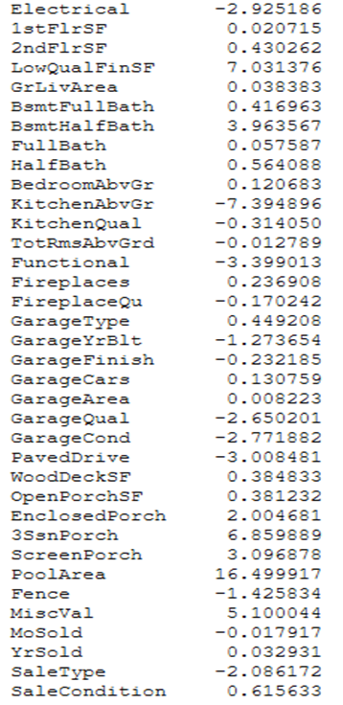
Most of the skewness are under control except few.
Therefore we are removing the variables like 'MiscVal', 'PoolArea', 'ScreenPorch', '3SsnPorch', 'EnclosedPorch', 'BsmtFinSF2' and 'Exterior2nd‘. And proceeding with building the model.

Slide 30
Assumptions
The uncontrollable skewness in few variables are due to presence of outliers in the dataset
We assume that all the variables follow normal distribution
The presence of little multi-collinearity in the dataset will not affect the prediction.
Scaling the data in order to keep all the variables with in the desired numerical range

Slide 31
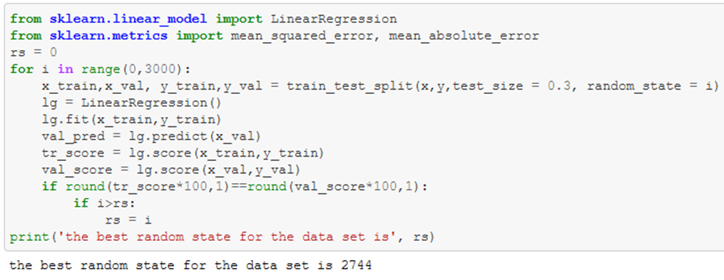
Further, before build the model we will have to split the data to test and train. The best possible way to split the data is by finding the best random state to split and the benefit is that we can control over fitting up to certain extent before even building the model.
We are trying to match the accuracy score of the training data set and the test dataset, which ever split (random state) satisfies the condition (R2 score of training dataset = R2 score of testing dataset). We’ll take the same random state to split the dataset and build the model.

Slide 32
Machine learning models
Below are the details of the machine learning model used
Machine Learning Models | R2 Score | Mean Absolute Error | cross validated R2 | Difference
Linear Regression | 0.875895 | 16863.62 | 0.850817 | 0.025078
Random Forest Regressor | 0.893162 | 14959.24 | 0.85171 | 0.041452
Extra Trees Regressor | 0.880354 | 14911.91 | 0.848371 | 0.031983
Ridge Regression | 0.875915 | 16861.68 | 0.850842 | 0.025073
XGB Regressor | 0.869115 | 16416.31 | 0.841277 | 0.027839

Slide 33


Using the table comparison in the previous slide, I have decided that Random Forest Regresor is the best model. Therefore I have performed Hyper-parameter tuning on the same to improve the scores
I have used GridSearchCV tool to perform the tuning and the hyper-tuned model achieved R2 score of 0.88 and the mean absolute error (MAE) of 15534.98
Base Model
Tuned Model
Since the base model achieved better R2 score and MAE, I’m keeping the base model as the best estimator

Slide 34
Result and conclusion
We have successfully built a model using multiple models and found that the Random Forest Regressor is the best one for the provided dataset.
Below are the details of the model’s metrics predicting the dataset
R2 score of 0.89
Mean Absolute Error of 14959.24

Slide 35
Major variables which are correlated with the target variable and is important in predicting the sale price of a house are
All the above mentioned variable affect the sales price of a house which we discussed in the pre-processing section and visualized each variable’s relation with the target
Important Features | Correlation Coefficient | Important Features | Correlation Coefficient
OverallQual | 0.789185 | Foundation | 0.374169
GrLivArea | 0.7073 | BsmtFinSF1 | 0.362874
GarageCars | 0.628329 | OpenPorchSF | 0.3395
GarageArea | 0.619 | 2ndFlrSF | 0.330386
TotalBsmtSF | 0.595042 | LotFrontage | 0.319416
1stFlrSF | 0.587642 | WoodDeckSF | 0.315444
FullBath | 0.554988 | HalfBath | 0.295592
TotRmsAbvGrd | 0.528363 | HeatingQC | -0.406604
YearBuilt | 0.514408 | GarageType | -0.41537
YearRemodAdd | 0.507831 | GarageFinish | -0.424922
MasVnrArea | 0.460535 | KitchenQual | -0.592468
Fireplaces | 0.459611 | BsmtQual | -0.601307
 |  | ExterQual | -0.62482

Slide 36
Limitations and Scope for Future Work
The amount of data is very less, it would be better to have more data to predict the sale price more accurately.
There are more outliers in the provided data and I wasn’t unable to remove all the outliers because I could lose data. With more data more outliers can be removed from the dataset.

Slide 37


